Slide 1
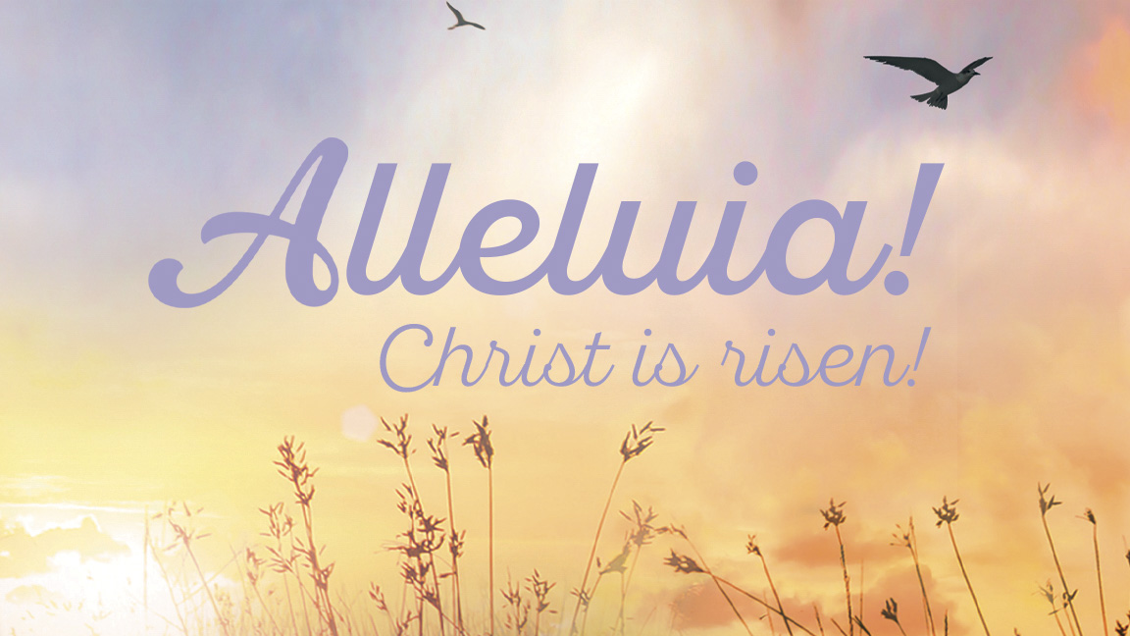
Welcome to worship at First Lutheran Church!
Notes:
Image: Mustard seed in spoon. Photo copyright © iStock/tycoon751. Used by permission.

Slide 2
Office Closed
Monday, April 21

Slide 3
Welcome to worship at First Lutheran Church!
Notes:
Image: Mustard seed in spoon. Photo copyright © iStock/tycoon751. Used by permission.

Slide 4
Thanksgiving for Baptism & Easter Proclamation
P: When we were baptized in Christ Jesus, we were baptized into his death. We were buried therefore with him by baptism into death,

Slide 5
so that as Christ was raised from the dead by the glory of the Father, we too might live a new life. For if we have been united with him in a death like his, we shall certainly be united with him in a resurrection like his.

Slide 6
P: Eternal God, maker of heaven and earth, who formed us from the dust of the earth, who by your breath gave us life, we glorify you.
C: We glorify you.

Slide 7
P: Jesus Christ, the resurrection and the life, who suffered death for all humanity, who rose from the grave to open the way to eternal life, we praise you.
C: We praise you.

Slide 8
P: Holy Spirit, author and giver of life, the comforter of all who sorrow, our sure confidence and everlasting hope, we worship you.
C: We worship you.

Slide 9
P: To you, O blessed Trinity, be glory and honor, forever and ever.
C: Amen.

Slide 10
P: Alleluia! Christ is risen!
C: Christ is risen indeed. Alleluia!

Slide 11
Jesus Christ is Risen Today
#365

Slide 12
Jesus Christ is ris’n today, Alleluia! our triumphant holy day, Alleluia! who did once upon the cross, Alleluia! suffer to redeem our loss. Alleluia!

Slide 13
Hymns of praise then let us sing, Alleluia! unto Christ, our heav’nly king, Alleluia! who endured the cross and grave, Alleluia! sinners to redeem and save. Alleluia!

Slide 14
But the pains which he endured, Alleluia! our salvation have procured; Alleluia! now above the sky he’s king, Alleluia! where the angels ever sing. Alleluia!

Slide 15
Sing we to our God above, Alleluia! praise eternal as his love; Alleluia! praise him, all you heav’nly host, Alleluia! Father, Son, and Holy Ghost. Alleluia!

Slide 16
P: This is the day that the Lord has made.
C: Let us be glad and rejoice in it!

Slide 17
P: Alleluia! Christ is risen!
C: Christ is risen indeed. Alleluia!

Slide 18
P: The grace of our Lord Jesus Christ, the love of God, and the communion of the Holy Spirit be with you all.
C: And also with you.

Slide 19
Prayer of the Day

Slide 21
Acts 10:34-43
Peter began to speak to [the people]: “I truly understand that God shows no partiality, but in every nation anyone who fears him and does what is right is acceptable to him. You know the message he sent to the people of Israel, preaching peace by Jesus Christ—he is Lord of all.

Slide 22
That message spread throughout Judea, beginning in Galilee after the baptism that John announced: how God anointed Jesus of Nazareth with the Holy Spirit and with power; how he went about doing good and healing all who were oppressed by the devil, for God was with him. We are witnesses to all that he did both in Judea and in Jerusalem.

Slide 23
They put him to death by hanging him on a tree; but God raised him on the third day and allowed him to appear, not to all the people but to us who were chosen by God as witnesses, and who ate and drank with him after he rose from the dead. He commanded us to preach to the people and to testify that he is the one ordained by God as judge of the living and the dead.

Slide 24
All the prophets testify about him that everyone who believes in him receives forgiveness of sins through his name.”

Slide 25
L: Word of God. Word of Life.
C: Thanks be to God.

Slide 26
Psalm 118:1-2, 14-24
L: Give thanks to the Lord, for the Lord is good; God’s mercy endures forever.
C: Let Israel now declare, “God’s mercy endures forever.”

Slide 27
L: The Lord is my strength and my song, and has become my salvation.
C: Shouts of rejoicing and salvation echo in the tents of the righteous: “The right hand of the Lord acts valiantly!

Slide 28
L: The right hand of the Lord is exalted! The right hand of the Lord acts valiantly!”
C: I shall not die, but live, and declare the works of the Lord.

Slide 29
L: The Lord indeed punished me sorely, but did not hand me over to death.
C: Open for me the gates of righteousness; I will enter them and give thanks to the Lord.

Slide 30
L: “This is the gate of the Lord; here the righteous may enter.”
C: I give thanks to you, for you have answered me and you have become my salvation.

Slide 31
L: The stone that the builders rejected has become the chief cornerstone.
C: By the Lord has this been done; it is marvelous in our eyes.

Slide 32
L: This is the day that the Lord has made; let us rejoice and be glad in it.

Slide 33
1 Cortinthians 15:19-26
If for this life only we have hoped in Christ, we are of all people most to be pitied. But in fact Christ has been raised from the dead, the first fruits of those who have died. For since death came through a human being, the resurrection of the dead has also come through a human being;

Slide 34
for as all die in Adam, so all will be made alive in Christ. But each in his own order: Christ the first fruits, then at his coming those who belong to Christ. Then comes the end, when he hands over the kingdom to God the Father, after he has destroyed every ruler and every authority and power.

Slide 35
For he must reign until he has put all his enemies under his feet. The last enemy to be destroyed is death.

Slide 36
L: Word of God. Word of Life.
C: Thanks be to God.

Slide 37
Good Christian Friends, Rejoice and Sing!
#385 vv. 1-2

Slide 38
Good Christian friends, rejoice and sing! Now is the triumph of our king! To all the world glad news we bring: Alleluia, alleluia, alleluia!

Slide 39
The Lord of life is ris’n this day; death’s mighty stone is rolled away; let all the earth rejoice and say: Alleluia, alleluia, alleluia!

Slide 40
Luke 24:1-12
P: The Holy Gospel according to Luke, the 24th chapter.
C: Glory to you, O Lord.

Slide 41
On the first day of the week, at early dawn, [the women] came to the tomb, taking the spices that they had prepared. They found the stone rolled away from the tomb, but when they went in, they did not find the body. While they were perplexed about this, suddenly two men in dazzling clothes stood beside them.

Slide 42
The women were terrified and bowed their faces to the ground, but the men said to them, “Why do you look for the living among the dead? He is not here, but has risen. Remember how he told you, while he was still in Galilee, that the Son of Man must be handed over to sinners, and be crucified, and on the third day rise again.”

Slide 43
Then they remembered his words, and returning from the tomb, they told all this to the eleven and to all the rest. Now it was Mary Magdalene, Joanna, Mary the mother of James, and the other women with them who told this to the apostles. But these words seemed to them an idle tale, and they did not believe them.

Slide 44
But Peter got up and ran to the tomb; stooping and looking in, he saw the linen cloths by themselves; then he went home, amazed at what had happened.

Slide 45
P: The Gospel of the Lord.
C: Praise to you, O Christ.

Slide 47
Prayers of Intercession
P: God of grace,
C: hear our prayer.

Slide 48
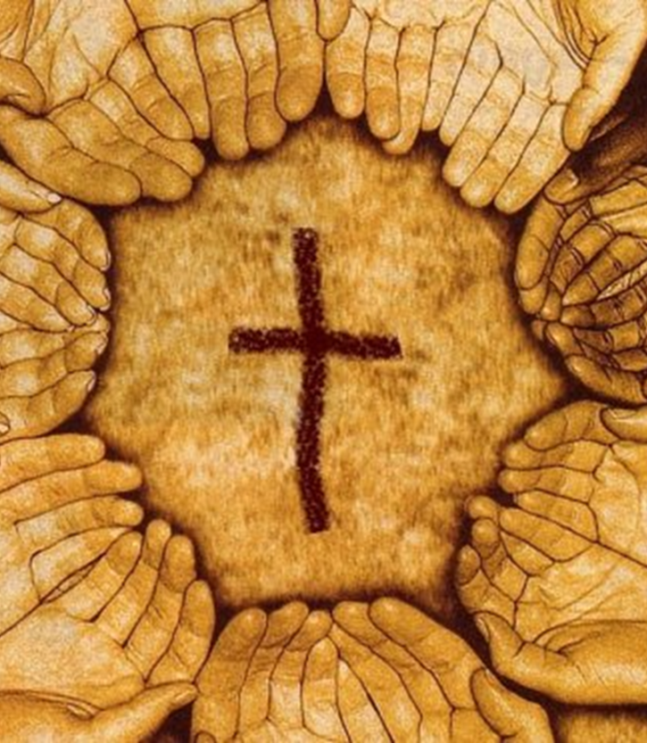
Peace
Offering

Slide 49
Good Christian Friends, Rejoice and Sing!
#385 v. 4

Slide 50
Your name we bless, O risen Lord, and sing today with one accord, the life laid down, the life restored: Alleluia, alleluia, alleluia!

Slide 51
Great Thanksgiving
P: The Lord be with you.
C: And also with you.
P: Lift up your hearts.
C: We lift them to the Lord.

Slide 52
P: Let us give thanks to the Lord our God.
C: It is right to give our thanks and praise.

Slide 53
Holy, Holy, Holy
#191

Slide 54
Holy, holy, holy are you, God of power and might; heaven and earth are filled with your glory. Hosanna in the highest.

Slide 55
Bless-ed is the one who comes in your name. Hosanna in the highest, hosanna in the highest.

Slide 56
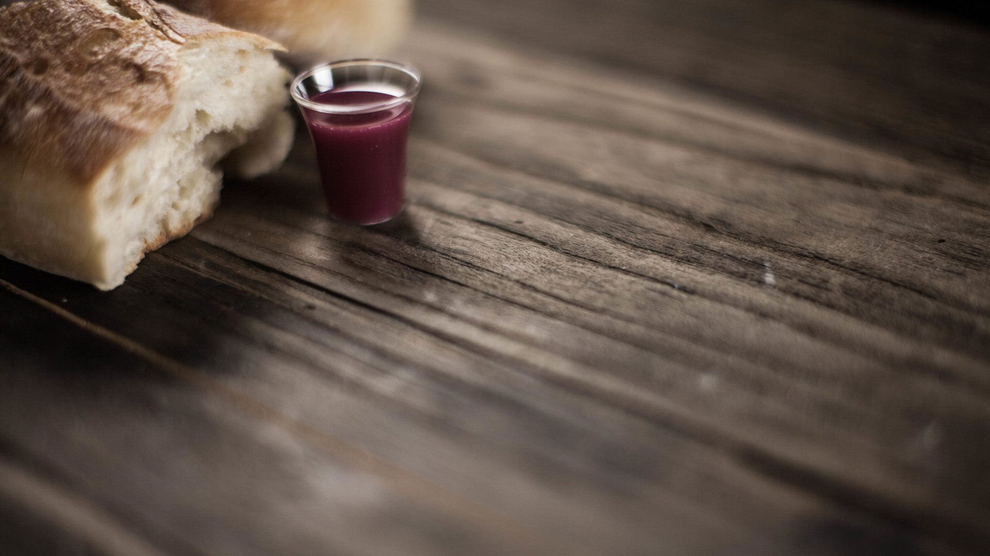
Words of Institution

Slide 57
Lord’s Prayer
Our Father, who art in heaven, hallowed be thy name, thy kingdom come, thy will be done, on earth as it is in heaven.

Slide 58
Give us this day our daily bread; and forgive us our trespasses, as we forgive those who trespass against us; and lead us not into temptation, but deliver us from evil.

Slide 59
For thine is the kingdom, and the power, and the glory, forever and ever. Amen.

Slide 60
Communion
All are welcome at the table.

Slide 61
Now All the Vault of Heaven Resounds
#367

Slide 62
Now all the vault of heav’n resounds in praise of love that still abounds: “Christ has triumphed! He is living!” Sing, choirs of angels, loud and clear!

Slide 63
Repeat their song of glory here: “Christ has triumphed! He is living!” Alleluia, alleluia, alleluia!

Slide 64
Eternal is the gift he brings, therefore our heart with rapture sings: “Christ has triumphed! He is living!”

Slide 65
Now still he comes to give us life and by his presence stills all strife. “Christ has triumphed! He is living!” Alleluia, alleluia, alleluia!

Slide 66
Oh, fill us, Lord, with dauntless love; set heart and will on things above that we conquer through your triumph;

Slide 67
Grant grace sufficient for life’s day that by our lives we truly say: “Christ has triumphed! He is living!” Alleluia, alleluia, alleluia!

Slide 68
Adoring praises now we bring and with the heav’nly blessed sing: “Christ has triumphed! Alleluia!”

Slide 69
Be to the Father, and our Lord, to Spirit blest, most holy God, all the glory, never ending! Alleluia, alleluia, alleluia!

Slide 70
Alleluia! Sing to Jesus
#392 vs. 1, 3, 4

Slide 71
Alleluia! Sing to Jesus; his the scepter, his the throne; Alleluia! his the triumph, his the victory alone.

Slide 72
Hark! The songs of peaceful Zion thunder like a mighty flood: “Jesus out of ev’ry nation has redeemed us by his blood.”

Slide 73
Alleluia! Bread of heaven, here on earth our food, our stay; Alleluia! here the sinful flee to you from day to day.

Slide 74
Intercessor, friend of sinners, earth’s redeemer, hear our plea where the songs of all the sinless sweep across the crystal sea.

Slide 75
Alleluia! King eternal, Lord omnipotent we own; Alleluia! Born of Mary, earth your foot stool, heav’n your throne.

Slide 76
As within the veil you entered, robed in flesh, our great high priest, here on earth both priest and victim in the eucharistic feast.

Slide 77
I Know That My Redeemer Lives!
#619

Slide 78
I know that my Redeemer lives! What comfort this sweet sentence gives! He lives, he lives, who once was dead; he lives, my ever-living head!

Slide 79
He lives triumphant from the grave; he lives eternally to save; he lives exalted, throned above; he lives to rule his church in love.

Slide 80
He lives to grant me rich supply; he lives to guide me with his eye; he lives to comfort me when faint; he lives to hear my soul’s complaint.

Slide 81
He lives to silence all my fears; he lives to wipe away my tears; he lives to calm my troubled heart; he lives all blessings to impart.

Slide 82
He lives to bless me with his love; he lives to plead for me above; he lives my hungry soul to feed; he lives to help in time of need.

Slide 83
He lives, my kind, wise, heav’nly friend; he lives and loves me to the end; he lives, and while he lives, I’ll sing; he lives, my prophet, priest, and king!

Slide 84
He lives and grants me daily breath; he lives, and I shall conquer death; he lives my mansion to prepare; he lives to bring me safely there.

Slide 85
He lives, all glory to his name! He lives, my Savior, still the same; what joy this blest assurance gives; I know that my Redeemer lives!

Slide 86
Blessing

Slide 87
Thine is the Glory
#376

Slide 88
Thine is the glory, risen, conqu’ring Son; endless is the vict’ry thou o’er death hast won!

Slide 89
Angels in bright raiment rolled the stone away, kept the folded graveclothes where thy body lay.

Slide 90
Thine is the glory, risen, conqu’ring Son; endless is the vict’ry thou o’er death hast won!

Slide 91
Lo, Jesus meets thee, risen from the tomb! Lovingly he greets thee, scatters fear and gloom;

Slide 92
let his church with gladness hymns of triumph sing, for the Lord now liveth; death hath lost its sting!

Slide 93
Thine is the glory, risen, conqu’ring Son; endless is the vict’ry thou o’er death hast won!

Slide 94
No more we doubt thee, glorious Prince of life; life is naught without thee; aid us in our strife;

Slide 95
make us more than conqu’rors, through thy deathless love; bring us safe through Jordan to thy home above.

Slide 96
Thine is the glory, risen, conqu’ring Son; endless is the vict’ry thou o’er death hast won!

Slide 97
Dismissal
P: Alleluia! Christ is risen.
C: Christ is risen indeed. Alleluia!
P: Go in peace. In Christ you are made new. Alleluia!
C: Thanks be to God. Alleluia!

Slide 98
Please depart in silence.

